Slide 1
Yubiq Studio
Training Course
Enabling a digital circularity world

Slide 2
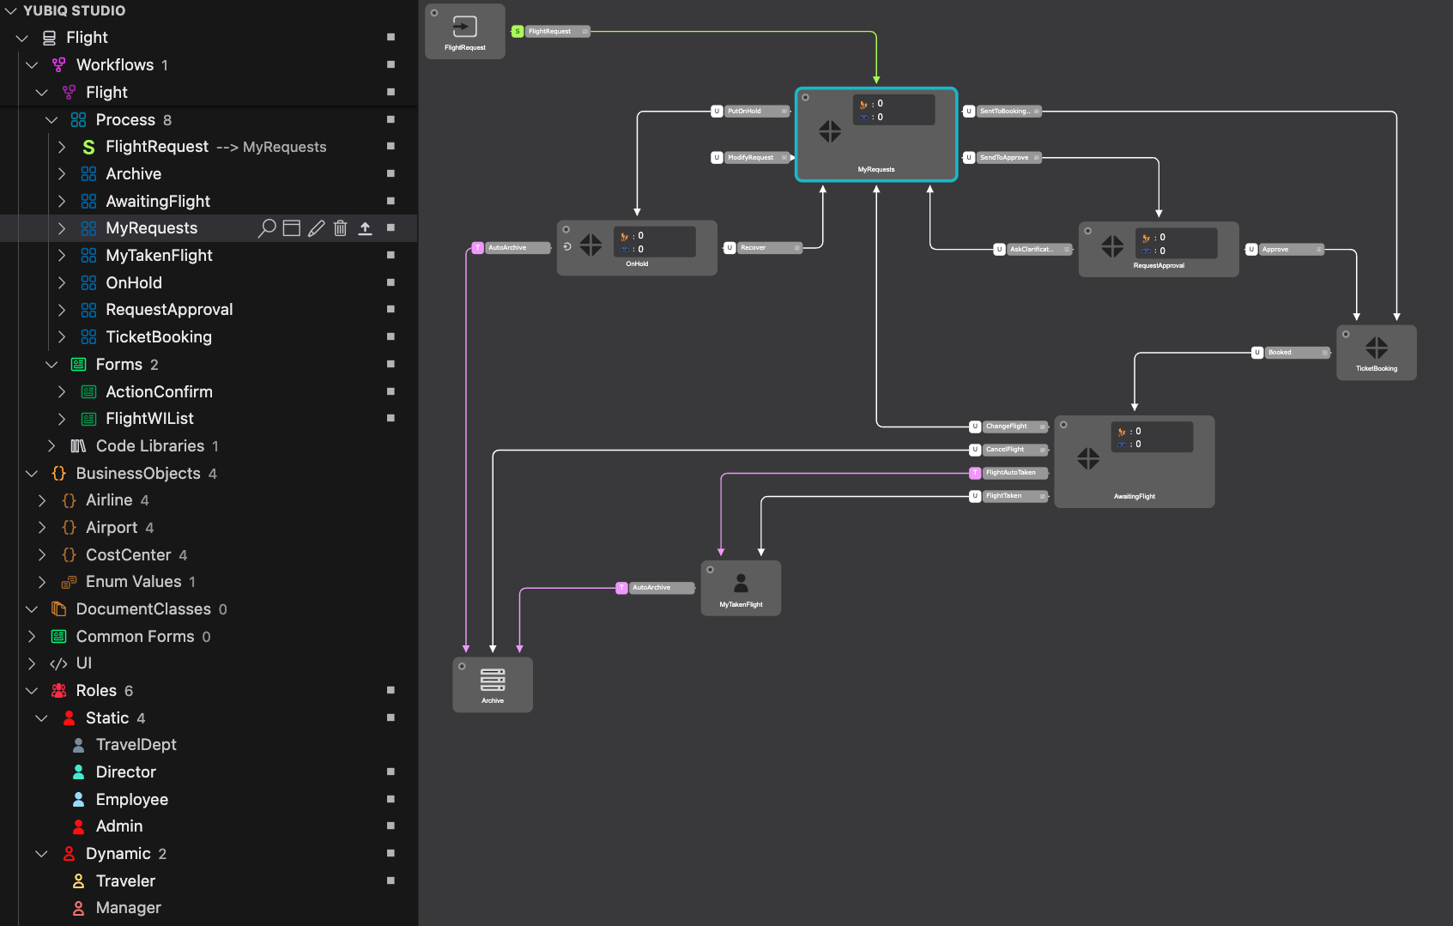
Training agenda
Part 1 | Yubiq BPM solution Overview
Part 2 | Star methodology
Part 3 | Visual Studio Code and Yubiq Studio Installation
Part 4 | The Sandbox
Part 5 | First Modelling (Ticketing process)
Part 6 | First Developing (Ticketing process)
Day 1
Day 2

Slide 3
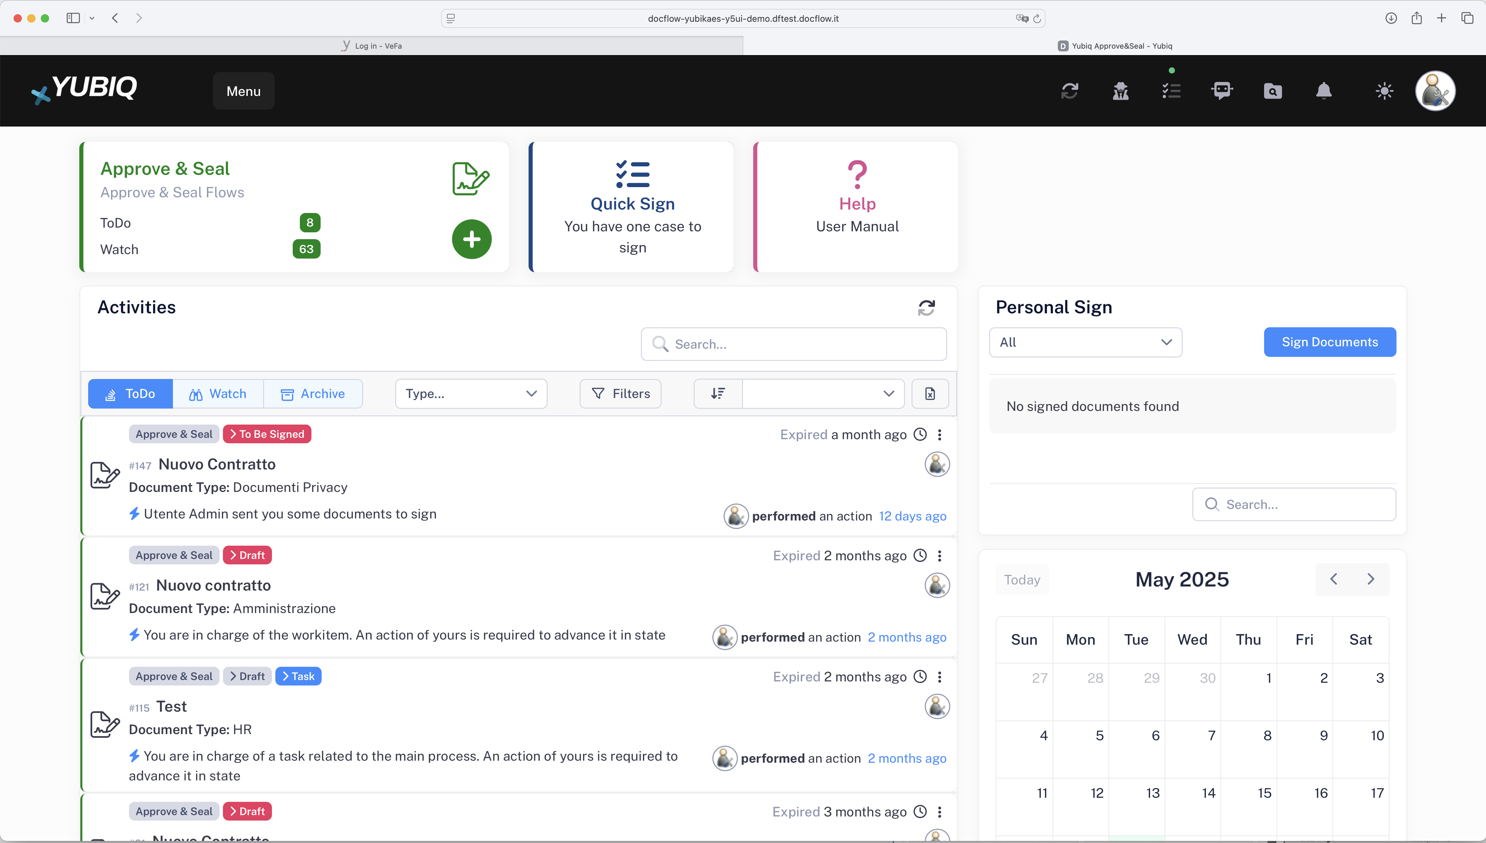
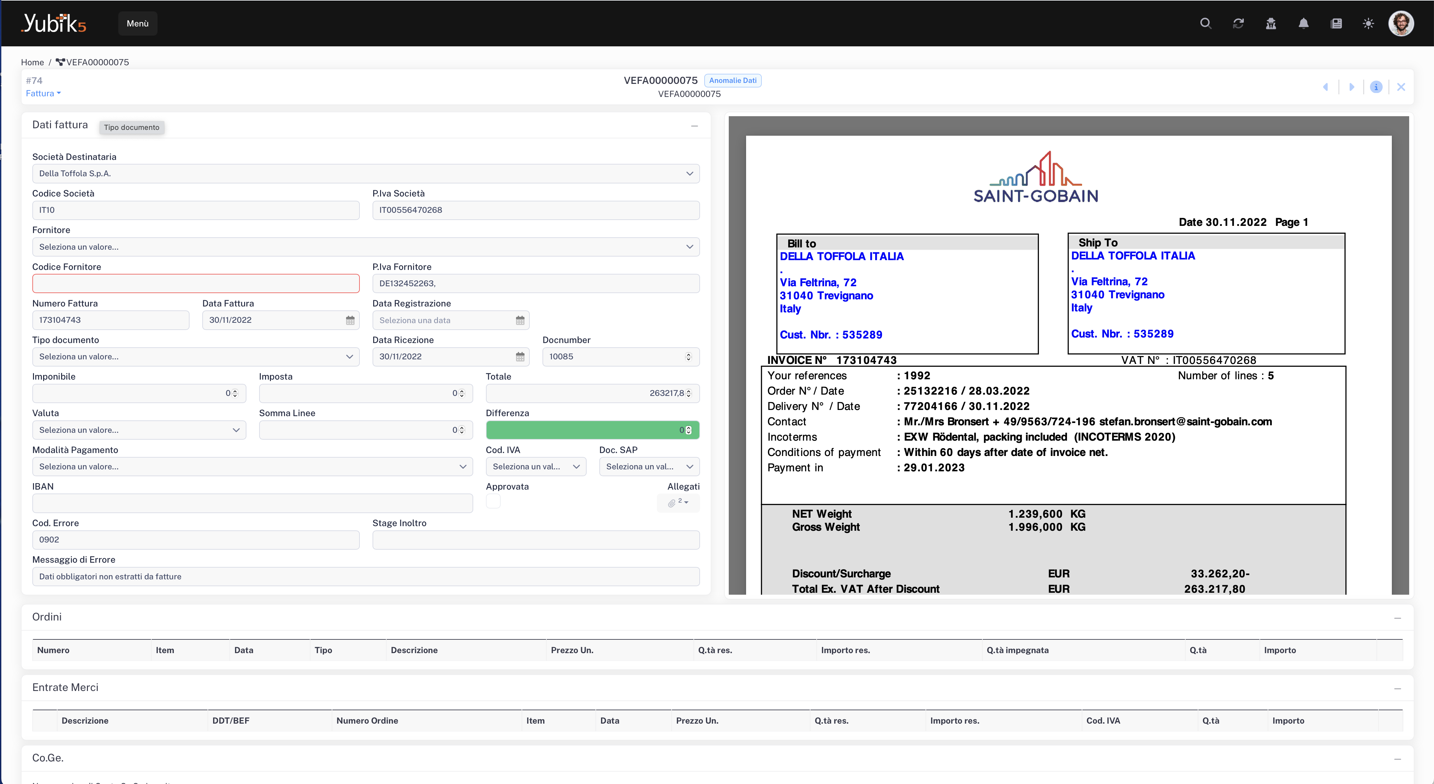
Part 1 : Yubiq BPM Overview
Yubiq is the platform with which we implement process automation solutions. Also called BPM (Business Process Management) or Workflow
Example 1: Yubiq A&S
Example 2: Yubiq ASC

Slide 4
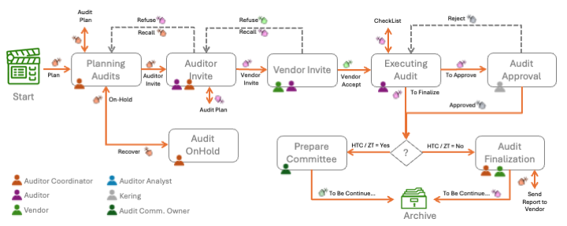
Part 2 : Star Methodology
The STAR (Stages, Action, and Roles) methodology was defined years ago, and is a Business Process Management (BPM) approach aimed at improving the efficiency and effectiveness of business processes.
It represents a structured approach to implementing Business Process Management (BPM).
Stages
Actions
Roles
WorkItem
Business Objects
Forms

Slide 5
Part 2 : Star Methodology :: Ticketing process description
The software support ticket management process is designed to streamline and structure the way support requests are handled within an organization. Built upon the STAR methodology — which stands for Stages, Actions, Roles, and WorkItem — the process ensures that every support request follows a clear, auditable path from its creation to its resolution and eventual closure.
It begins when a customer submits a ticket, typically through a form that captures essential information such as the issue’s title, description, priority, and any relevant attachments. This action initiates the process and places the ticket into the first stage: New Ticket. From here, the request is Took in charge up by a support agent, whose responsibility is to evaluate its content, determine the category of the issue (for example, whether it is software-related, hardware-related, or a network issue), and assign it an appropriate priority level (low, medium, high, or critical).
Once evaluated, the ticket enters the Under Evaluation stage, where the support team may contact the customer for further information if needed. This is where the first interactions begin, and the foundation for resolution is established. When enough information is available, the support agent assigns the ticket to a technician, moving it to the In Progress stage. At this point, a member of the technical team becomes responsible for analysing and solving the problem.
As work progresses, there might be a need for additional feedback or clarification from the customer. In such cases, the ticket moves into the Waiting for Customer stage, pausing the technical work until the required input is received. Once the issue has been addressed and the solution verified by the technician, the ticket is marked as Resolved. However, it is not closed immediately: this provides a final opportunity for the customer to review the solution, test its effectiveness, or raise further questions.
After a predefined period or following explicit customer confirmation, the ticket moves into the Closed stage. This marks the end of the lifecycle for the support request. Every ticket, treated as a WorkItem, carries with it a full history of actions taken, timestamps, the individuals involved, and all related content such as attachments and comments.
Underpinning the entire system are various Business Objects. These include representations of customers and technicians, categorized types of issues, and enumerated priority levels. They ensure data consistency, enable dynamic assignment of tasks, and facilitate reporting and analytics.
All interactions within the process are facilitated through purpose-built forms, tailored for each role and stage. Customers use an intuitive form to submit tickets, support agents work with classification and assignment interfaces, and technicians fill out resolution forms to document their work. In some implementations, a feedback form is also provided to collect customer satisfaction data and improve service quality.
This process, when implemented with tools like Yubiq Studio, allows for both no-code configuration for business analysts and deep customization by developers. It fosters collaboration, traceability, and service excellence, ensuring that technical issues are addressed promptly, effectively, and transparently.

Slide 6
Part 2 : Star Methodology :: Ticketing
This document describes the support ticket management process for software solutions, based on the STAR methodology (Stages, Actions, Roles) and using Yubiq Studio (YS). The process covers the full ticket lifecycle, from creation to closure, enabling tracking, collaboration, and automation.
Stages
New Ticket: Request is created by the user.
Under Evaluation: Support team evaluates the request.
In Progress: The ticket is assigned to a developer or technician.
Waiting for Customer: Awaiting customer feedback or confirmation.
Resolved: The ticket has been addressed and resolved.
Closed: The ticket is permanently closed.
Actions
Create Ticket
Assign Technician
Request Information
Update Status
Mark as Resolved
Close Ticket
Roles
Customer: End user who reports the issue.
Support: Operator who evaluates the request.
Technician: Specialist responsible for solving the issue.
Admin: Has full visibility and permissions across the process
WorkItem
Id (unique)
Title
Description
Priority
Status
Open Date
Close Date
Assignee
Customer
Attachments
Business Objects
Customer: Contains user info (ID, Name, Email, Company).
Technician: List of available technicians (ID, Name, Skills).
Category: Type of issue (Software, Hardware, Network, etc).
Priority: Enum with values (Low, Medium, High, Critical).
Forms
TicketForm: Enter issue details by the customer.
EvaluationForm: Allows support to classify and assign the ticket.
ResolutionForm: Allows technician to document the fix and mark as resolved.
FeedbackForm: Optional, allows customer to provide feedback.

Slide 7



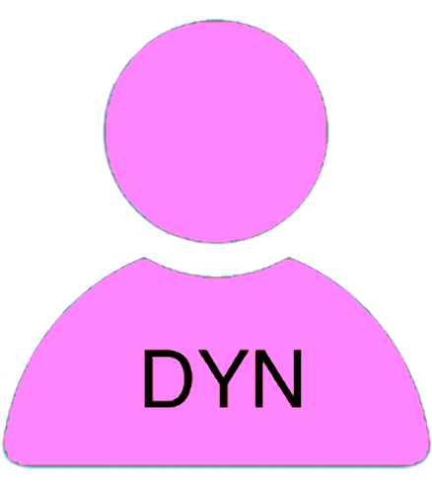




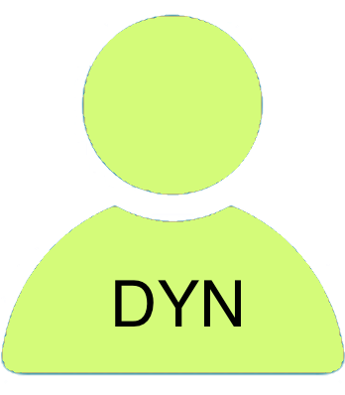
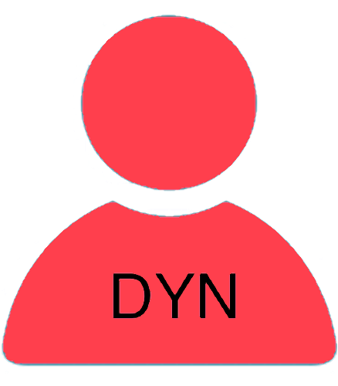






Part 2 : Star Methodology :: Modelling page !
Auto Release
New Tickets
Under Evaluation
Under Evaluation
…
Watch
Watch
Watch
Create Ticket
ToDo
Take in Charge
ToDo
Dispatch
ToDo
Start Stage
Ask AI
Cancel Ticket
Respond
Ask
Clarification
Evaluate
My Quastions
Watch
Cancel Ticket
ToDo
Archive Stage
Static Roles
Stage
Watch
Customer
Req. Customer
ToDo
Form 1
User Action
Support
Ass. Support
Form 2
Conditional Action
Technician
Ass. Technician
Archive Stage
Form 3
Timed Action
Start Stage

Slide 8
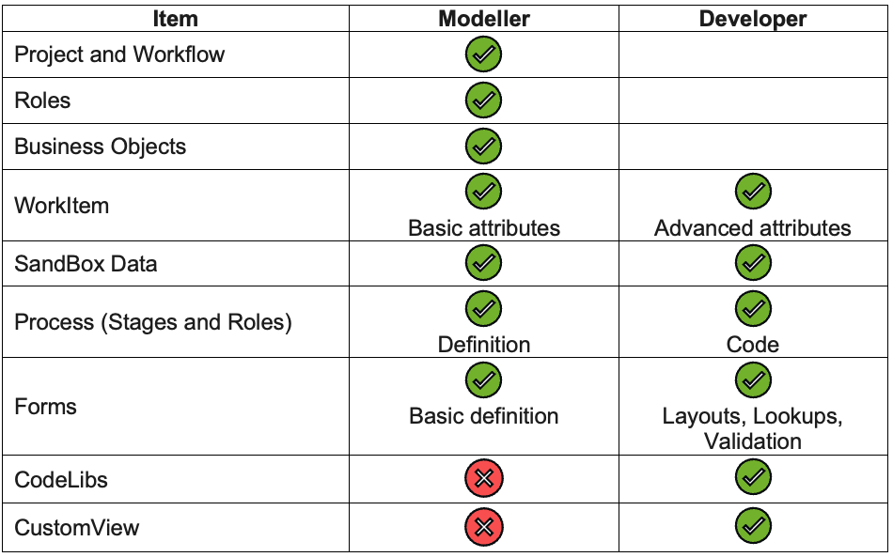

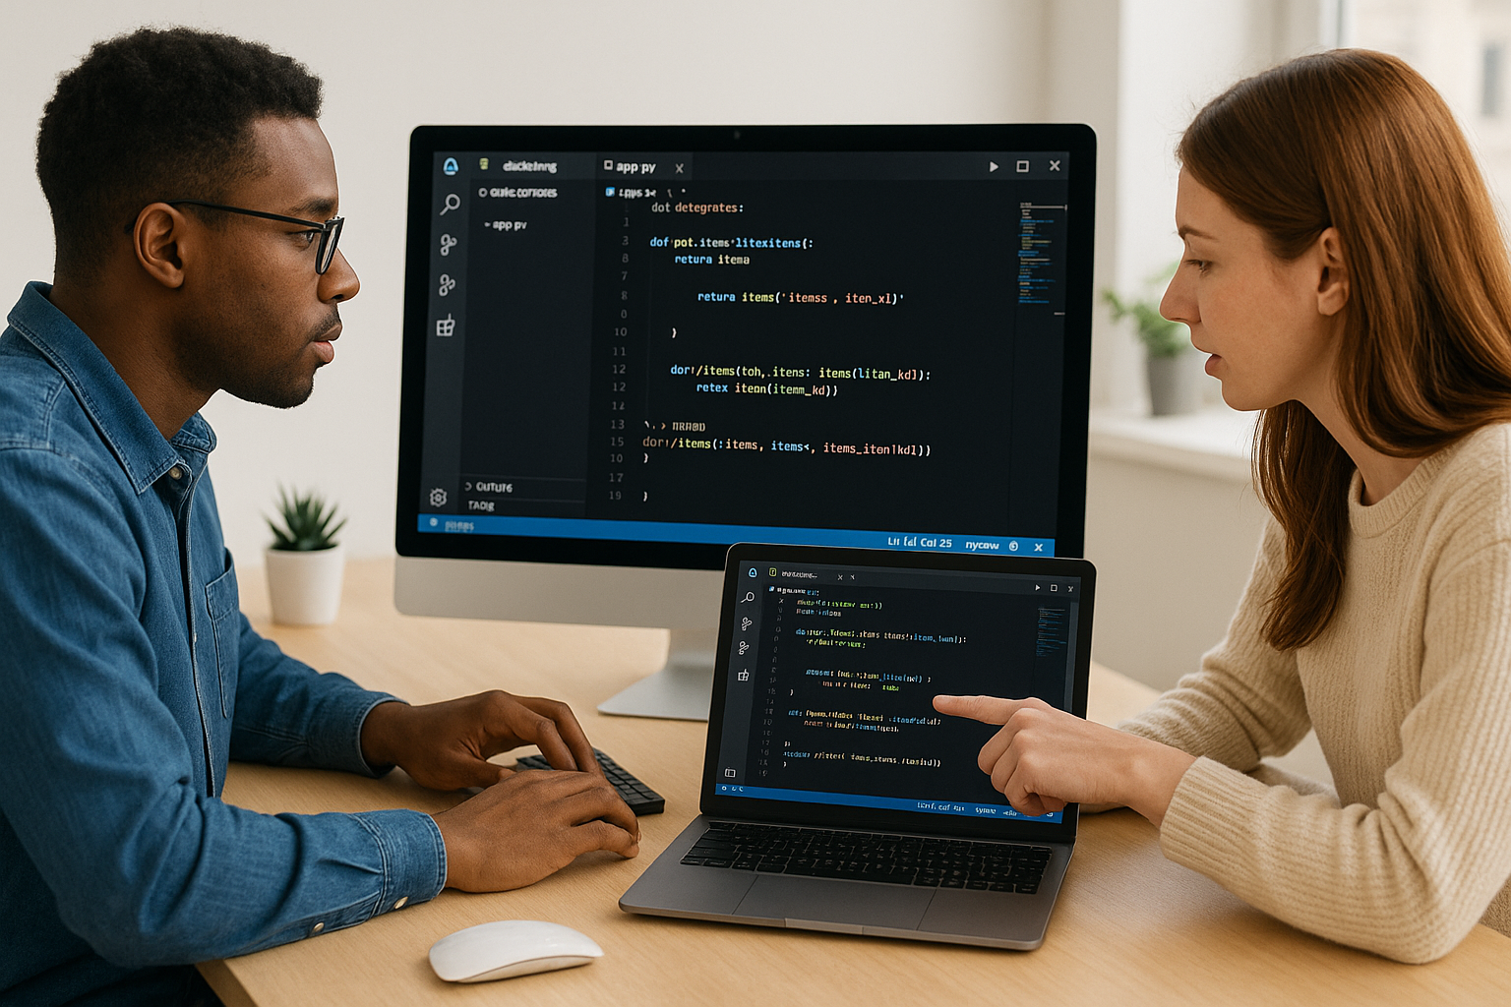
Part 2 : Star Methodology :: Modelling Vs Developing

Slide 9

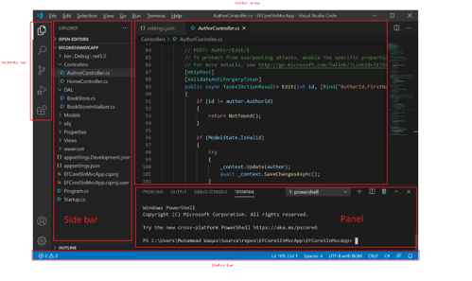
Part 3 : VSC & YS Installation
Yubiq Studio is based entirely on Visual Studio Code, (VSC or vscode), is a free source code editor developed by Microsoft for Windows, macOS and Linux. Features include debugging, syntax highlighting, intelligent code completion, snippets, code refactoring, and built-in version control with Git. With nearly 75 percent market share and 14 million users, VSCode is the most popular IDE available (source Wikipedia).
Because VSC is a generic IDE there are over 30,000 extensions in its store that allow you to customize virtually anything in the IDE. YS is formally a Visual Studio Code extension, which can be downloaded and installed from the Microsoft store.

Slide 10
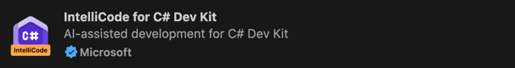
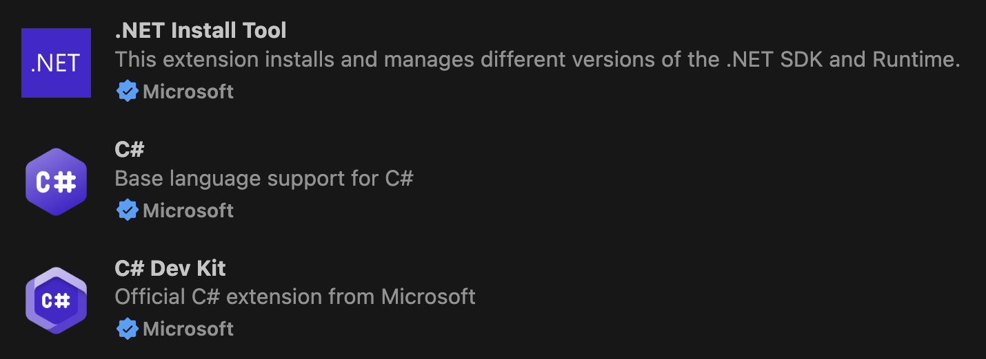

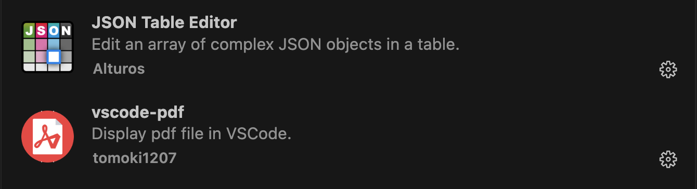
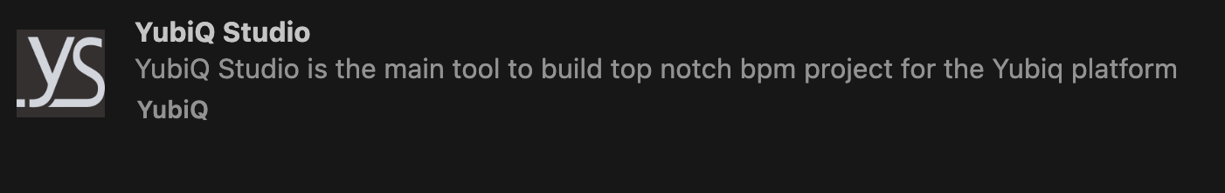
Part 3 : VSC & YS Installation
Once you have installed VSC on a Windows or MAC environment (Linux is not supported at the moment) proceed with the installation of the .NET 8 SDK: https://dotnet.microsoft.com/en-us/download/dotnet/8.0
And thus, of the following extensions of VSC. Microsoft .NET C#: The basic extensions of .NET C# development.
GitHub Copilot: For adding AI during development. Strongly recommended especially if you have a full user license!
Utility extensions: We also recommend installing the following extensions that provide useful functionality during development:
Yubiq Studio: Finally, we install the extension for Yubiq Studio!

